Slide 1
Tidyverse
Introduction to Computational CMB
Alex Alon
February 19th, 2025

Slide 2
Wednesday Objectives
Learn about tidy data
Learn about dplyr and tidyr
Learn about ’pipe’ operator %>%
Manipulate data using dplyr -- select, slice, filter, mutate, summarize, group_by, count
Learn about wide vs long table format
Manipulate data using tidyr -- reshape a data frame from long to wide and back using pivot_wider and pivot_longer

Slide 3
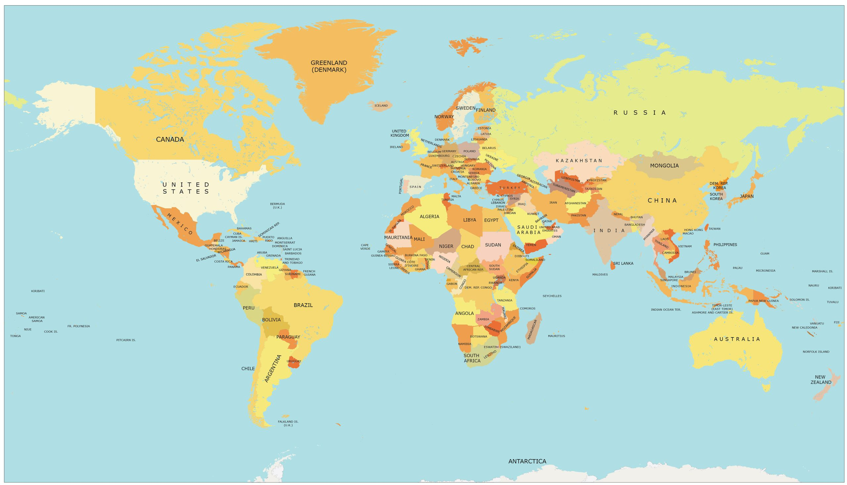


Slide 4

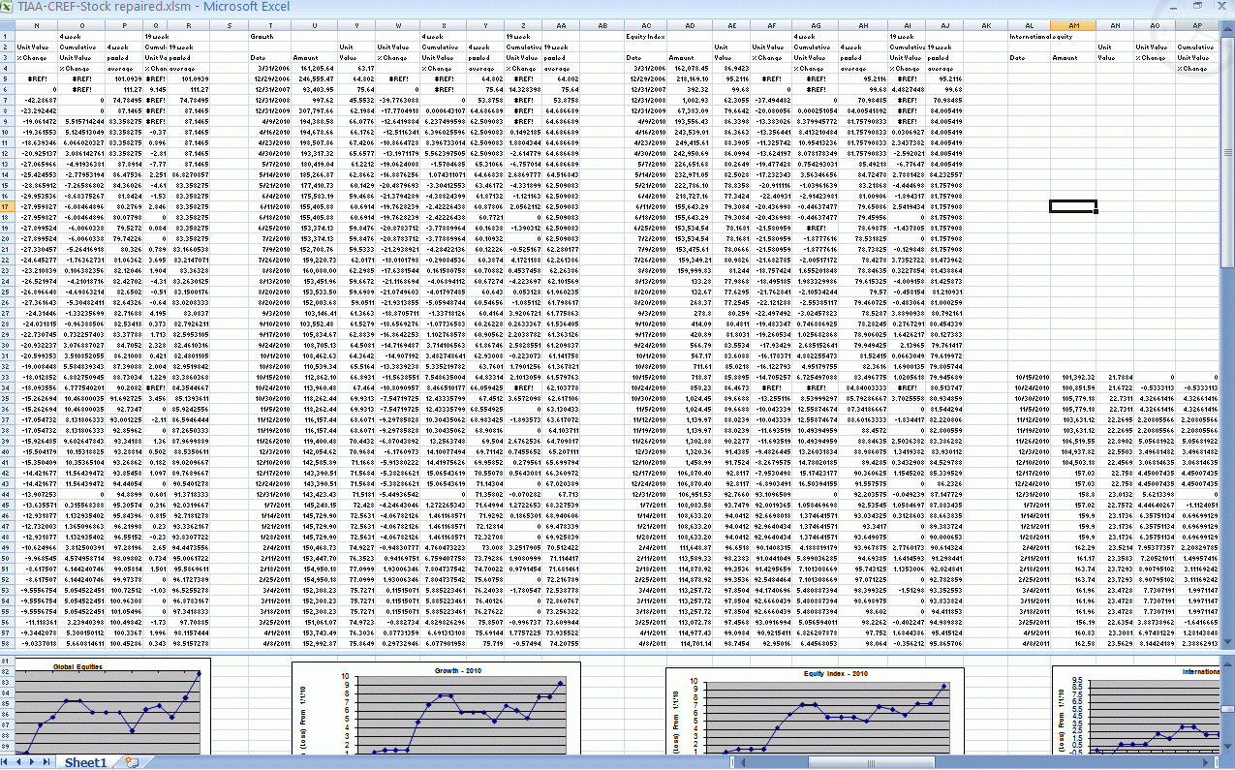


Slide 5
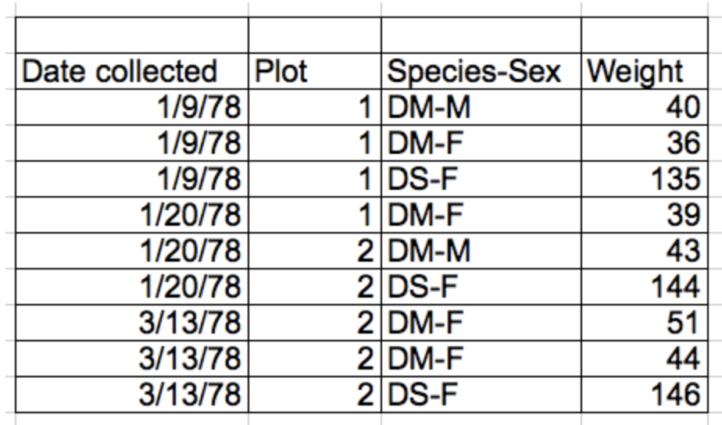
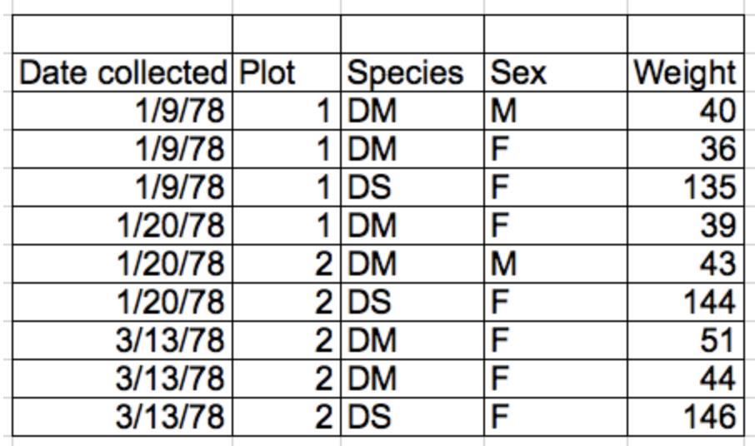
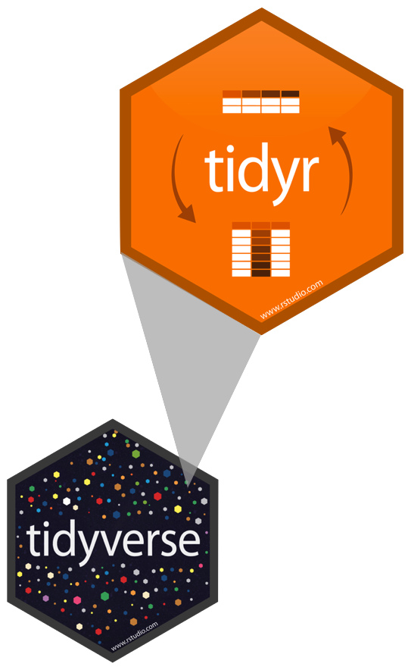
Tidy Data
Rules defining tidy data:
Each unique variable has its own column – thing you are measuring
Each observation has its own row
Each value must have its own cell – don’t combine data in a single cell!
Leave the raw data raw
Each type of observational unit forms a table
columns = variables, rows = observations, cells = data

Slide 6
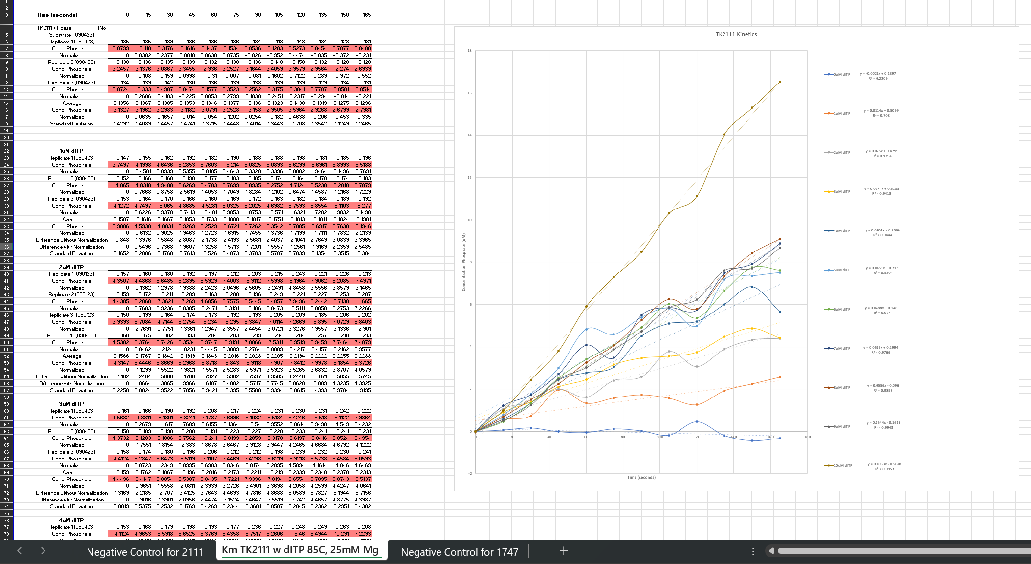
Columns include values
Color coding
Rows have variables with repeating names
Statistics and data
Manipulation performed on data sheet
Graph made on spreadsheet
Multiple Tabs of Analysis

Slide 7
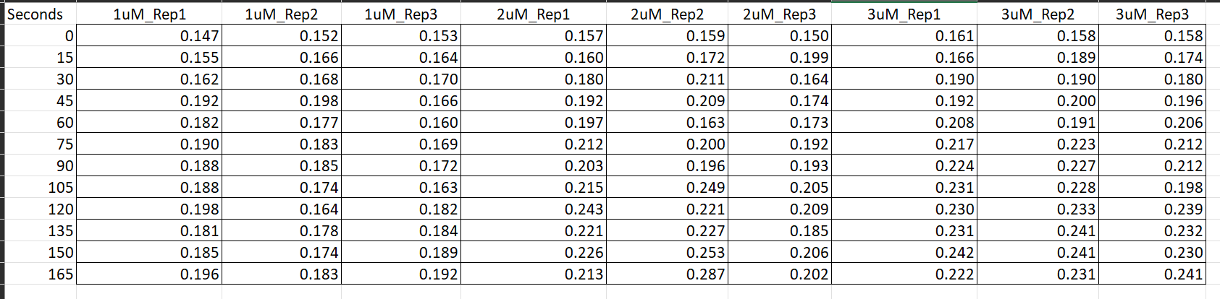
Is this tidy data?

Slide 8
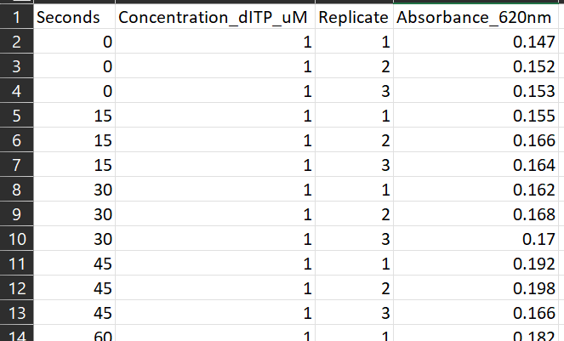

Unique Column for Replicates
Unique column variable names

Slide 9
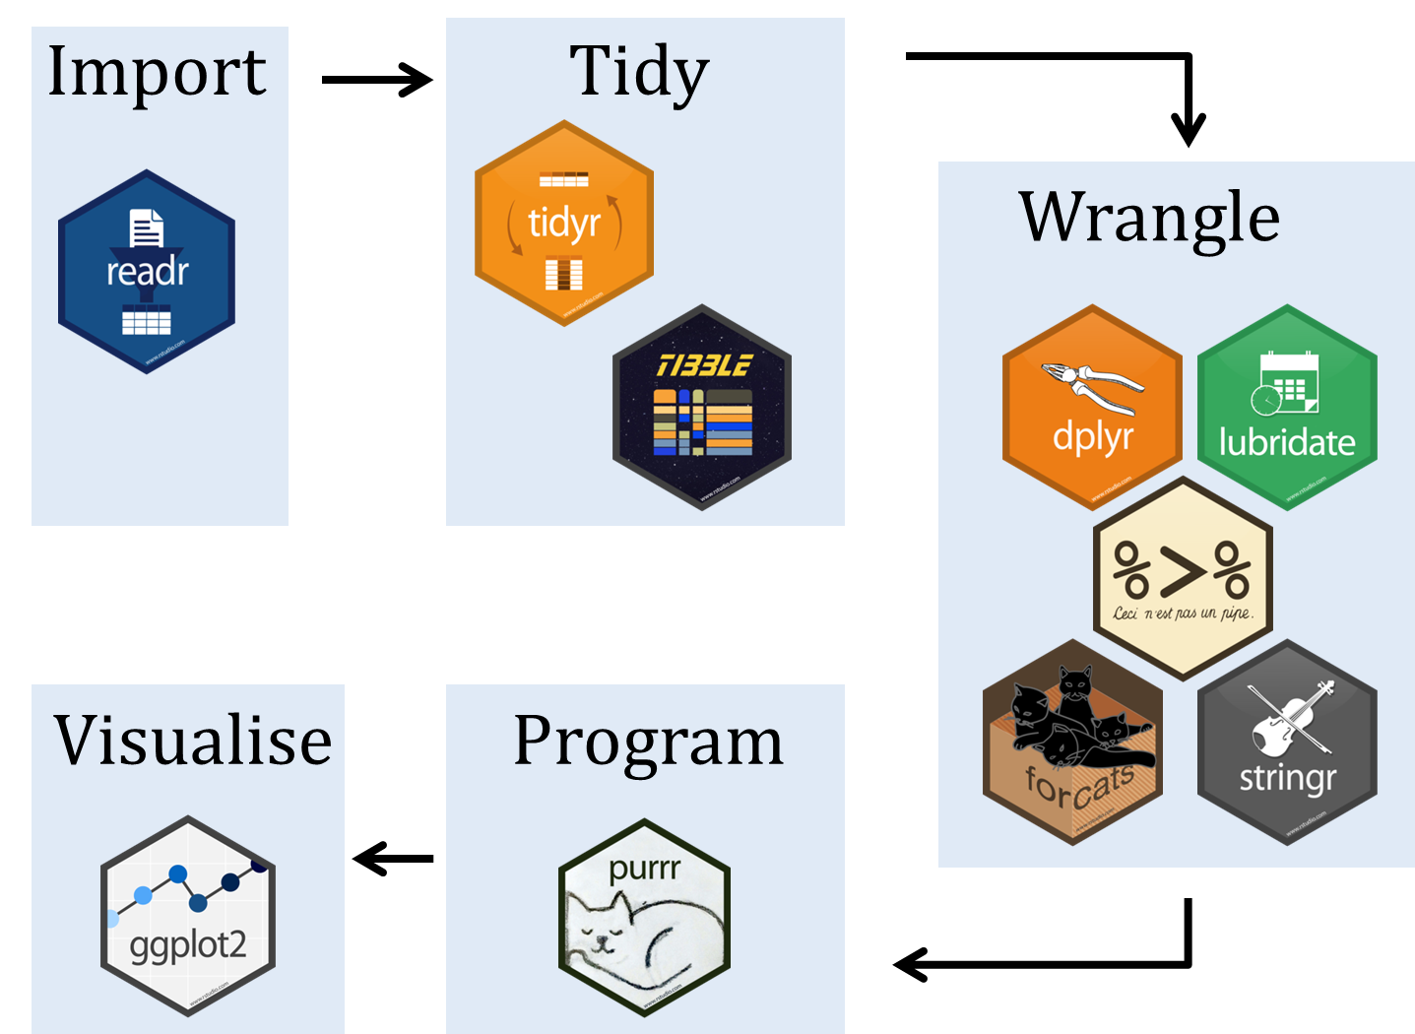

What is tidyverse?

Slide 10
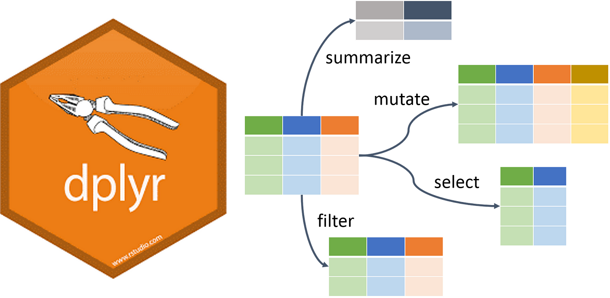
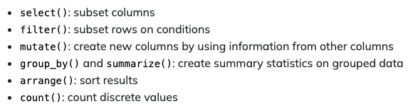
What is dplyr?

Slide 11
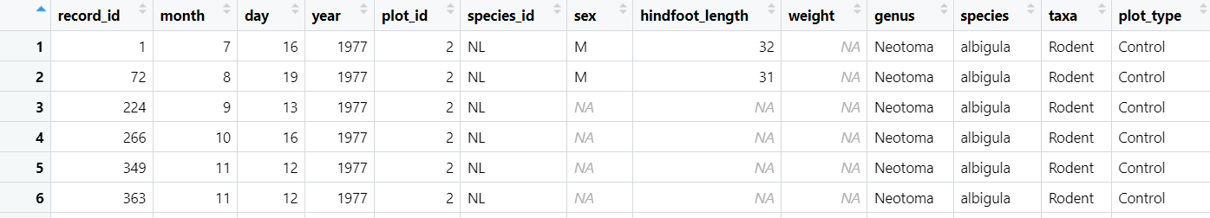
Dplyr: Selecting columns
Selecting columns of a data frame
Format: select(df, col1, col2)
Selecting all columns except certain ones
Format: select(df, -col1, -col2)

Slide 12
Dplyr: Filtering rows
Filtering rows
Format: filter(df, col1 >300 & col1 <100)

Slide 13
filter(!is.na(surveys$sex))

Slide 14
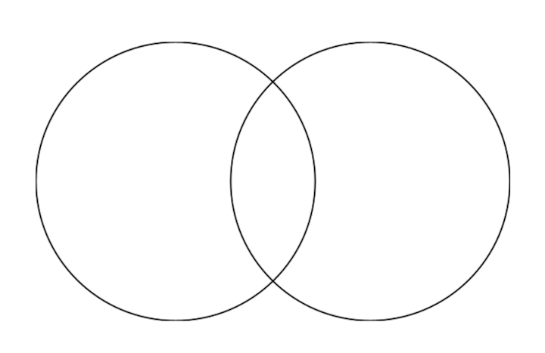
Dplyr: Filtering for multiple conditions
filter(!is.na(surveys$sex)) – filter out NA values
AND
filter( sex == M & year <=1978)
Has to meet both conditions
filter( sex == M | year <=1978)
Has to meet on condition or the other
1977
1978
1979
1980
1981
…
M
F
NA
Sex = M
Year <= 1978
OR

Slide 15
PRACTICE TIME

Slide 16
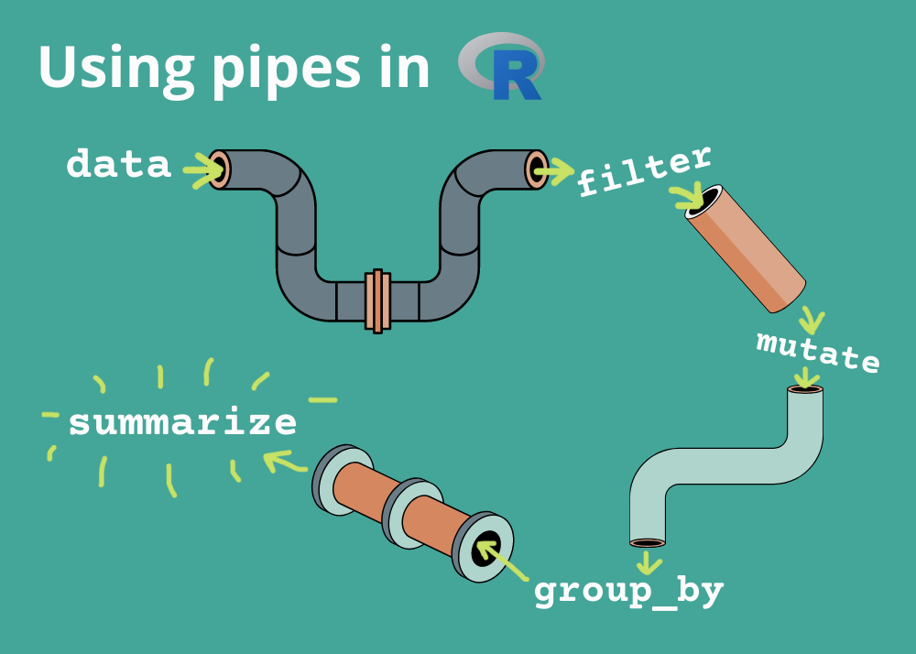
What are pipes? %>%
With dplyr we can perform a series of operations using pipes
Pipes will send the results of one function into another using the pipe operator (%>%)
One line of code is now equivalent to multiple

Slide 17
Dplyr: Pipes
Piping shortcut!
Without Pipes
surveys_2<- filter(surveys$sex == M)
surveys_3<-select(surveys_2$species_ed, sex, weight)
With Pipes
surveys %>%
filter(sex == M) %>%
select(species_id, sex, weight)

Slide 18
Dplyr: Pipes
Piping into new object
surveys_sml <- surveys %>%
filter(sex == M) %>%
select(species_id, sex, weight)
surveys %>%
filter(sex == M) %>%
select(species_id, sex, weight)
*Does not change surveys variable*
surveys <- surveys %>%
filter(sex == M) %>%
select(species_id, sex, weight)
*Does change surveys variable*

Slide 19
Dplyr: Mutate
Creating new columns based on existing columns (for example, unit conversion or find the ratio between two columns)
To create a new column of weight in kg:
surveys %>%
mutate(weight_kg = weight / 1000)
To create a second column based off first new column:
surveys %>%
mutate(weight_kg = weight / 1000,
weight_lb = weight_kg * 2.2)

Slide 20
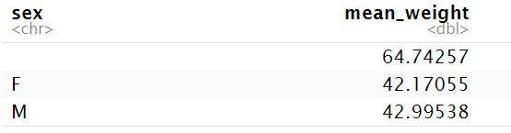
Dplyr: Group_by and summarize
Split-apply-combine paradigm: split the data into groups, apply some analysis to each group, and then combine the results
Group_by() is often used together with summarize(), which collapses each group into a single row summary of that group.
Step 1: Grouping by sex
Step 2: Summarizing mean weight (removing NAs)
Stepwise:
surveys2 <- group_by(surveys, sex)
surveys_sml <- summarize(mean_weight = mean(weight, na.rm = TRUE))

Slide 21
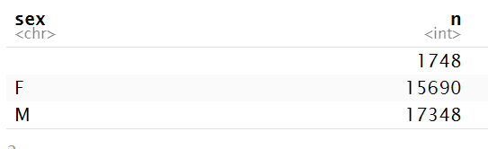
Dplyr: Counting
If we want to know the number of observations found for each factor or combinations of factors, we can use count().
surveys %>%
count(sex)
To count a combination of factors
surveys %>%
count(sex, species)
To count a combination of factors AND sort output
surveys %>%
count(sex, species)%>%
arrange(species, desc(n))

Slide 22
PRACTICE TIME

Slide 23
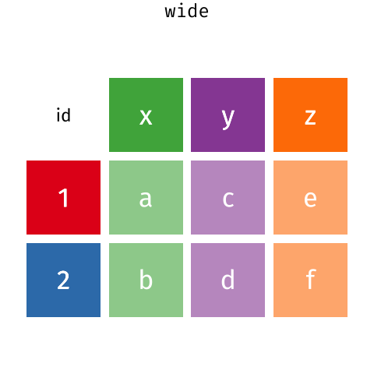
What is tidyr?

Slide 24
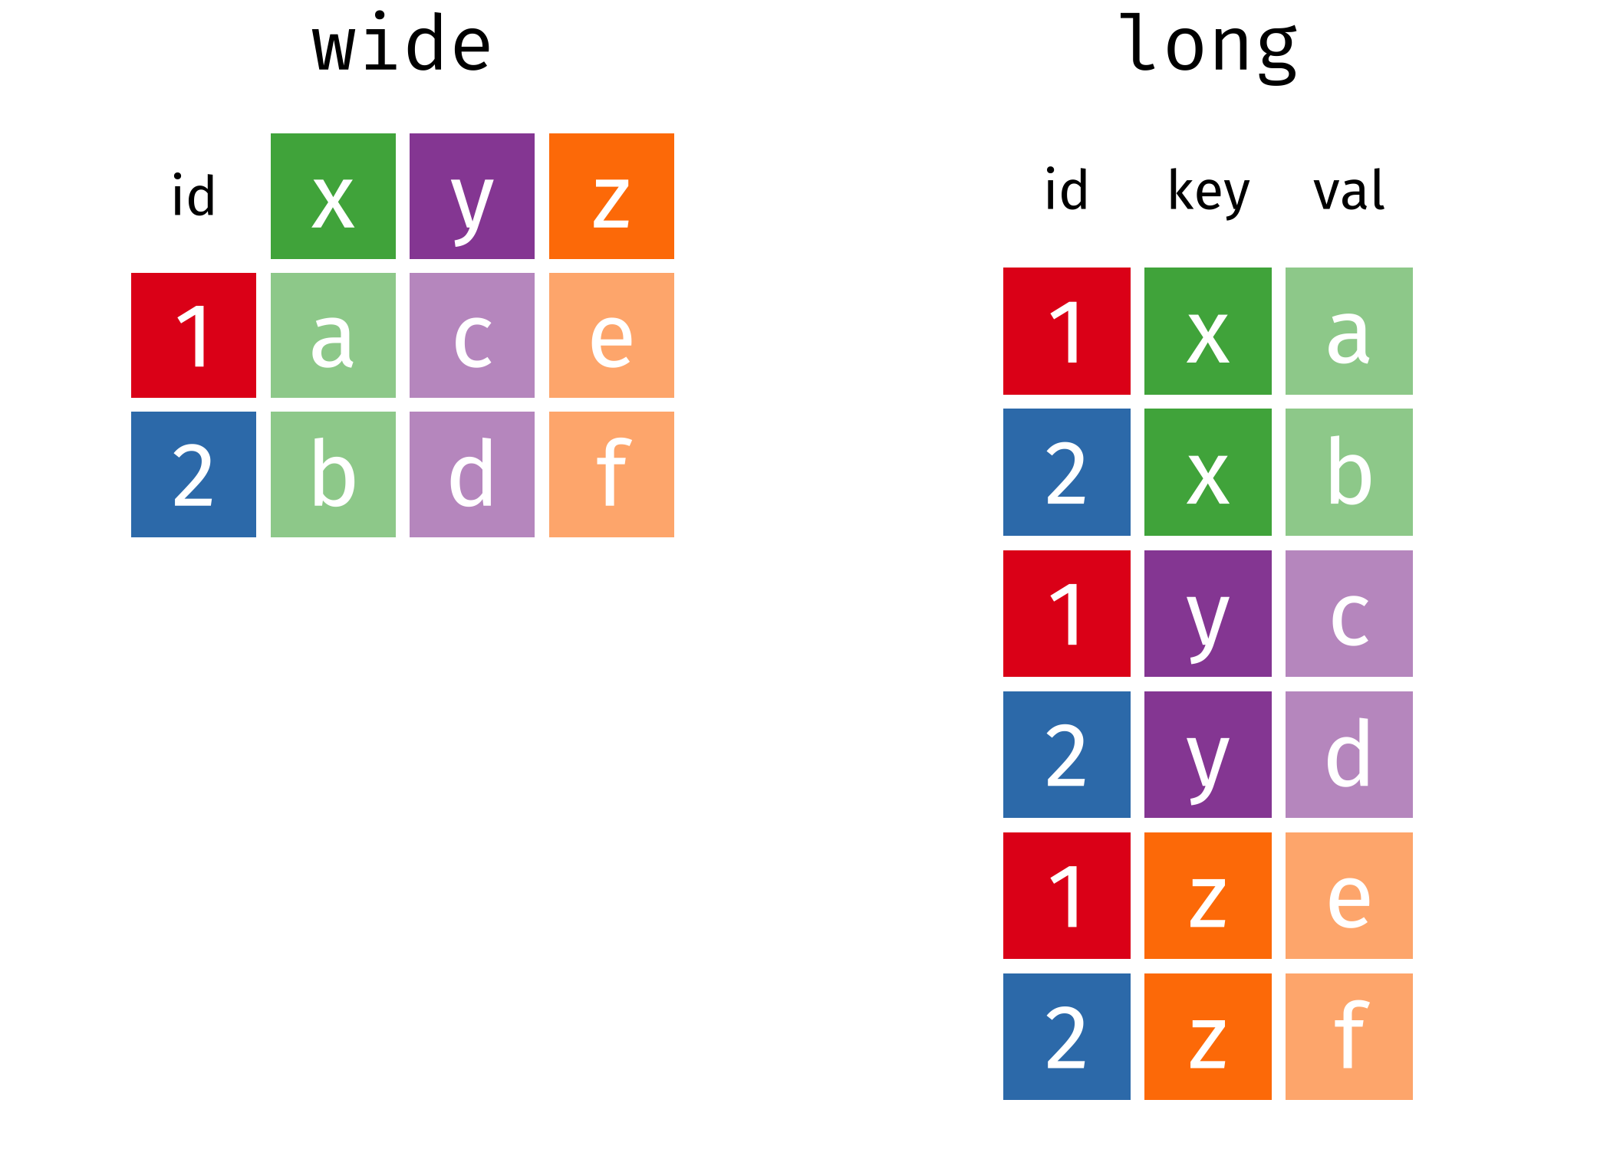
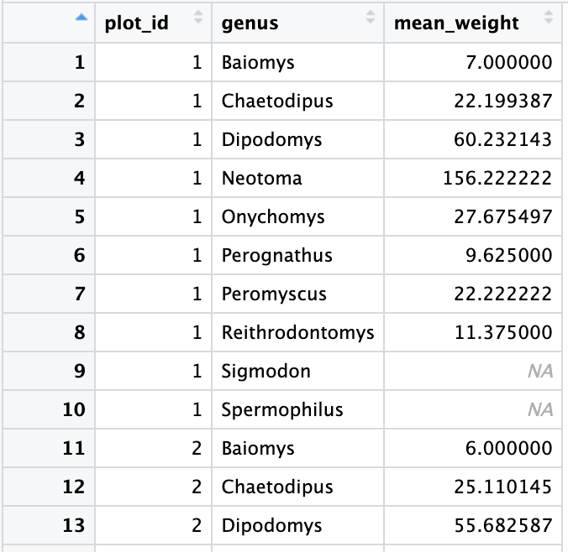
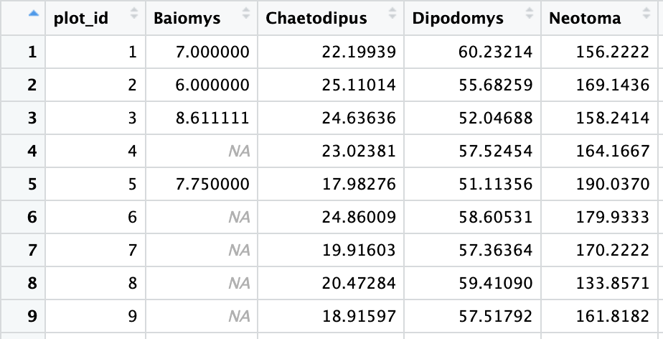
Tidyr: Wide vs. Long Format

Slide 25
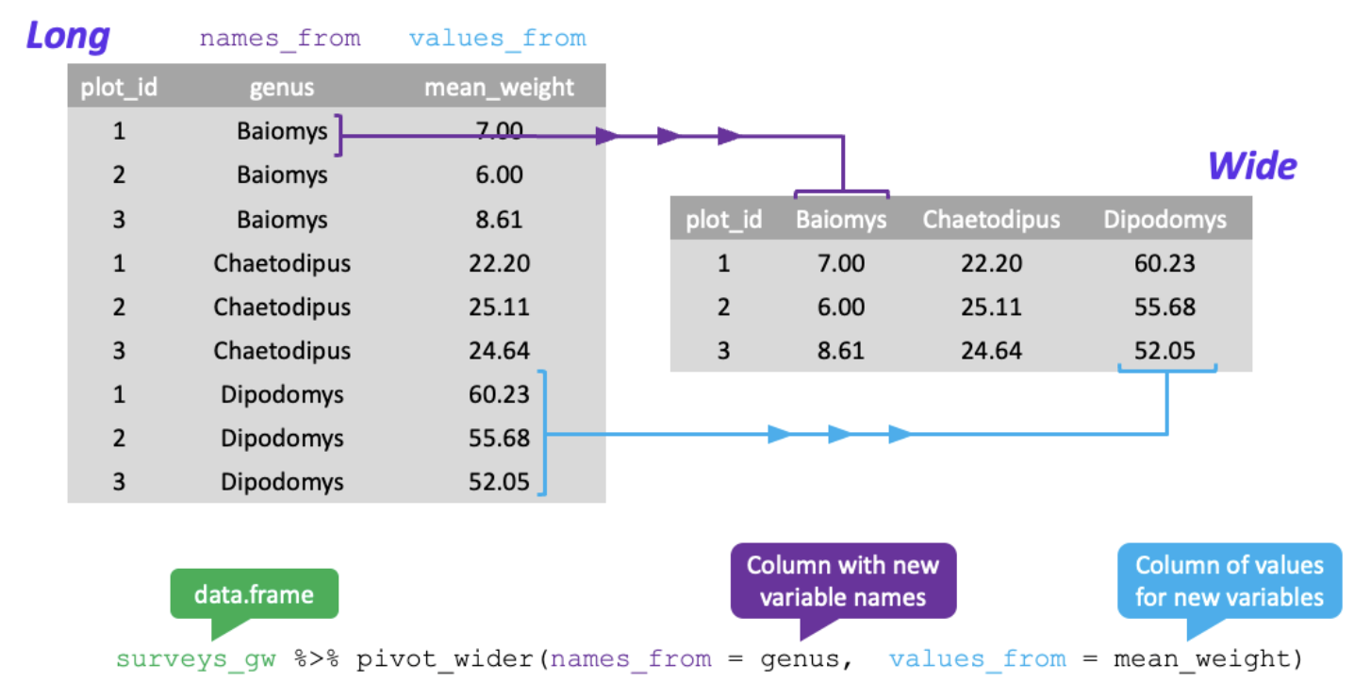
Tidyr: Pivoting from long to wide format

Slide 26
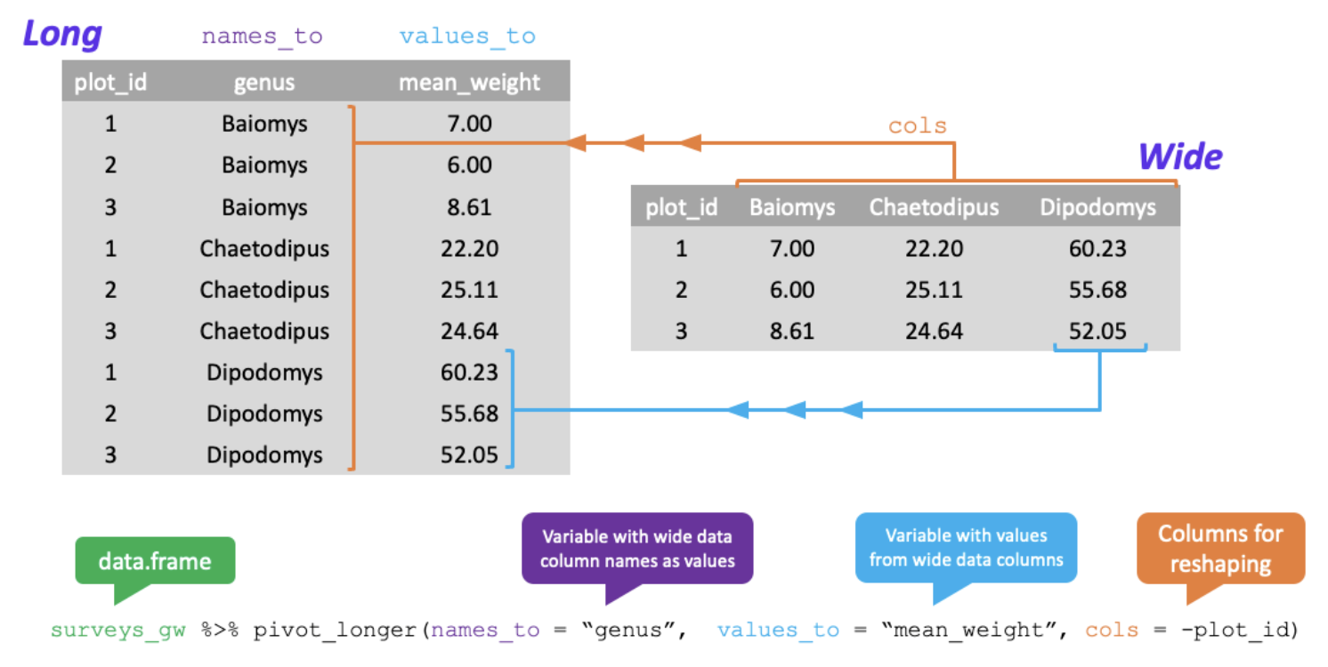
Tidyr: Pivoting from wide to long format

Slide 27
When do I Want Wide Format vs Long Format?
Row-wise calculations
Clustered Calculations
Max between x, y, and z
g
Group_by
Summarize
h
Where a,c, and e are summarized values of keys a,b, and c

Slide 28
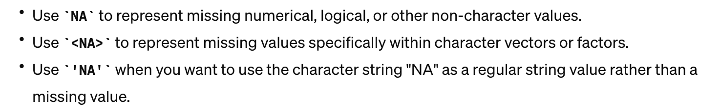
Dplyr: Group_by and summarize NaN?? NA? What the heck.

